Slide 1


Instructor: Person McDuderson
Beginner Excel
Part 1

Slide 2
Agenda
What is Excel?
Key Vocabulary
Visual Overview
Entering Data
Project
Create and customize an Excel spreadsheet.
Enter Data

Slide 3
Vocabulary
Spreadsheet
Row
Column
Sheet

Slide 4

What is Microsoft Excel?
Program used to enter, store, analyze, and present quantitative data
Creates electronic versions of spreadsheets (collection of text and numbers laid out in a grid)
Displays values calculated from data
Allows what-if analysis
Ability to change values in a spreadsheet and assess the effect they have on calculated values

Slide 5
Sample Project Part 1
Take a few minutes to create your own Excel Spreadsheet
-Open Excel
-Save spreadsheet

Slide 6
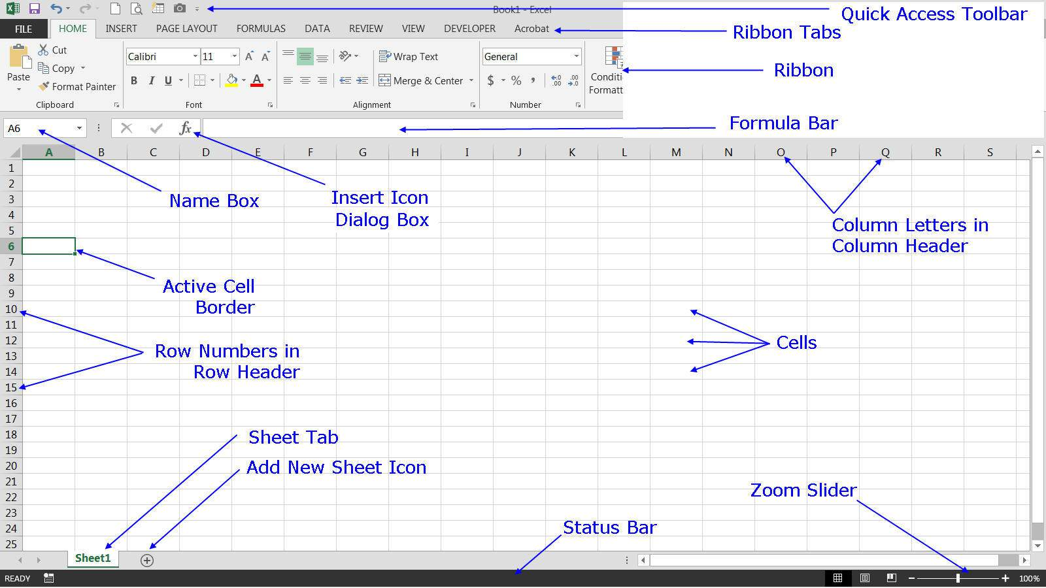

Slide 7
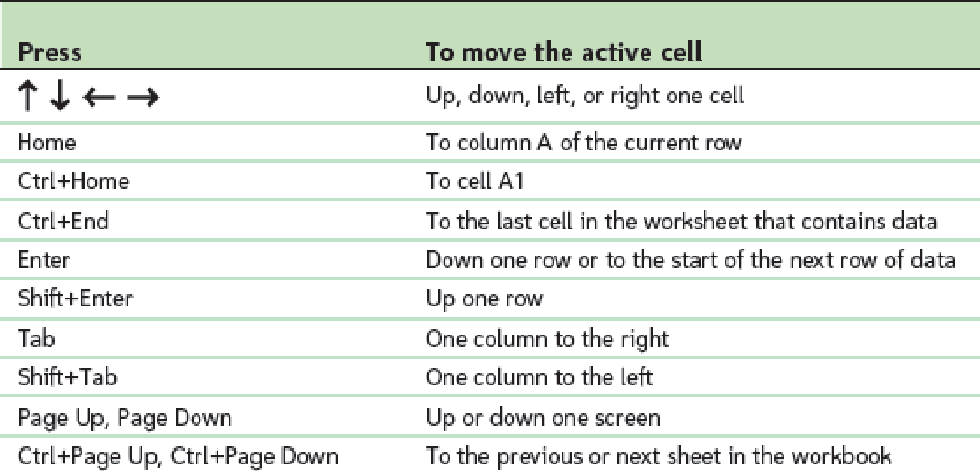
Worksheet Navigation Keys

Slide 8
Entering Text, Numbers, and Dates
Text data
Combination of letters, numbers, and symbols
Often referred to as a text string
Number data
Numerical value to be used in a mathematical calculation
Date and time data
Commonly recognized formats for date and time values

Slide 9
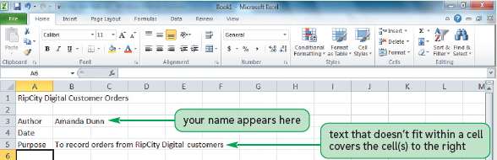
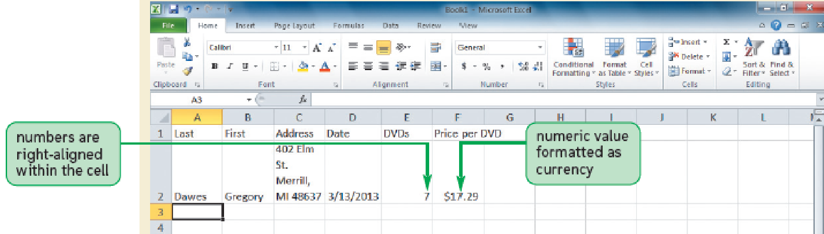
Entering Text and Numbers
New data appears in both the active cell and the formula bar
Truncation
AutoComplete feature
To enter multiple lines of text within a cell
Create a line break with Alt + Enter

Slide 10
Working with Columns and Rows
To make data easier to read:
Modify size of columns and rows in a worksheet
To modify size of columns or rows:
Drag border to resize
Double-click border to autofit
Format the Cells group to specify
Column width
Expressed in terms of number of characters or pixels (8.43 characters equals 64 pixels)
Note: Pixel size is based on screen resolution
Row height
Measured in points (1/72 of an inch) or pixels
Default row height: 15 points or 20 pixels

Slide 11
Sample Project Part 2
Customize your Excel spreadsheet
-Change row length
-Change column height
-Type into cell

Slide 12
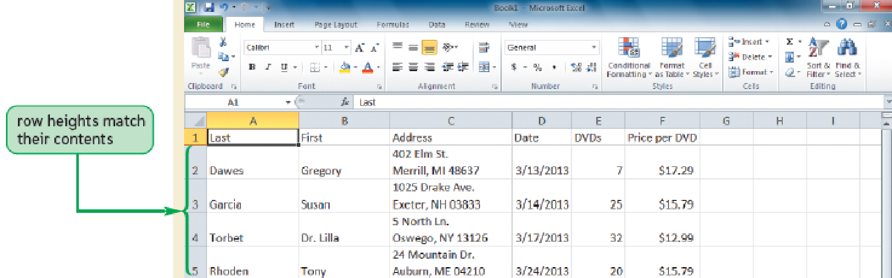
Working with Columns and Rows

Slide 13
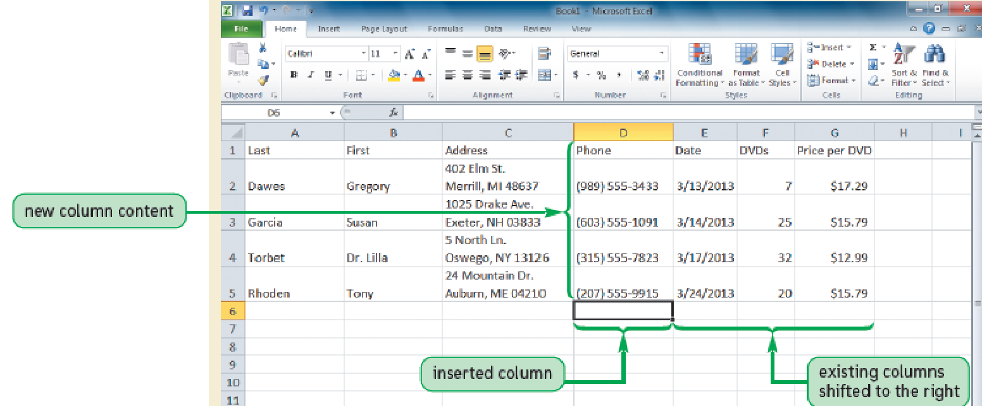
Working with Columns and Rows
Inserting a column or row
Existing columns or rows shift to accommodate

Slide 14
Working with Columns and Rows
Deleting and clearing a row or column
Deleting removes both the data and the cells
Clearing removes the data, leaving blank cells where data had been

Slide 15
Sample Project Part 3
Change rows and columns
-Create new row
-Delete row
-Create new column
-Delete column

Slide 16
Questions?

Slide 18
Instructor: Person McDuderson
Excel
Part 2

Slide 19
Agenda
Formates, Formulas, and Functions
Key Vocabulary
Project
Create and customize an Excel Spreadsheet
Use simple formulas and functions

Slide 20
Vocabulary
Formulas
functions

Slide 21
Sample Project Part 1
Take a few minutes to create your own Excel Spreadsheet
-Open Excel
-Save spreadsheet

Slide 22
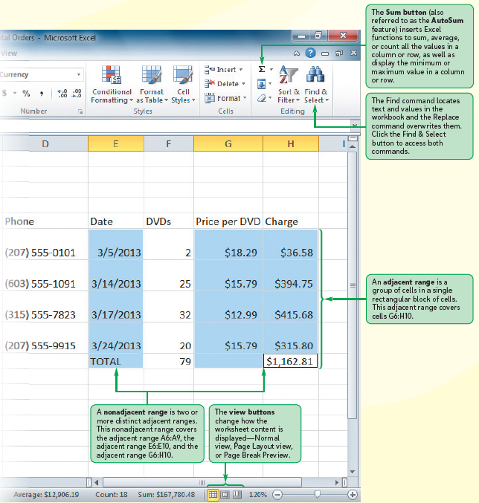
Worksheet
Data

Slide 23
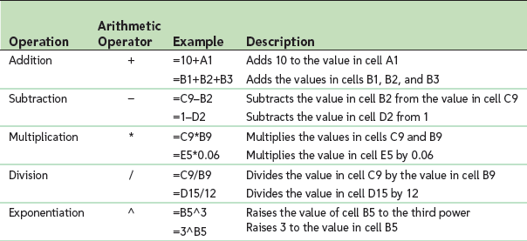
Working with Formulas
Formula
An expression that returns a value
Written using operators that combine different values, resulting in a single displayed value

Slide 24
Working with Formulas
Entering a formula
Click cell where you want formula results to appear
Type = and an expression that calculates a value using cell references and arithmetic operators
Cell references allow you to change values used in the calculation without having to modify the formula itself
Press Enter or Tab to complete the formula

Slide 25
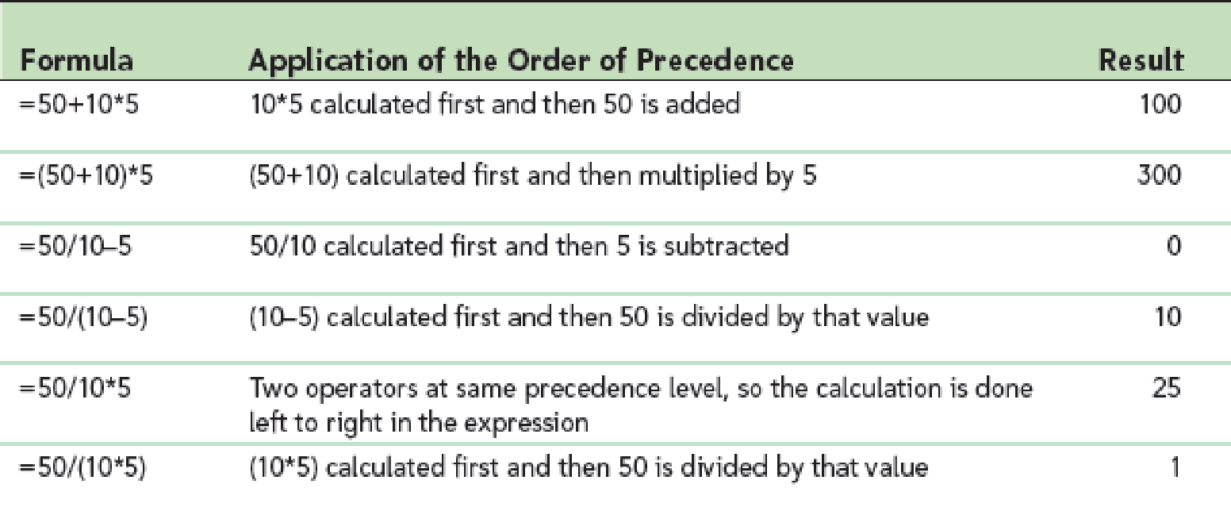
Working with Formulas
Order of precedence
Set of predefined rules used to determine sequence in which operators are applied in a calculation

Slide 26
Sample Project Part 2
Enter a simple formula
-type two small numbers in two adjacent cells
-use the function line to add the two numbers

Slide 27
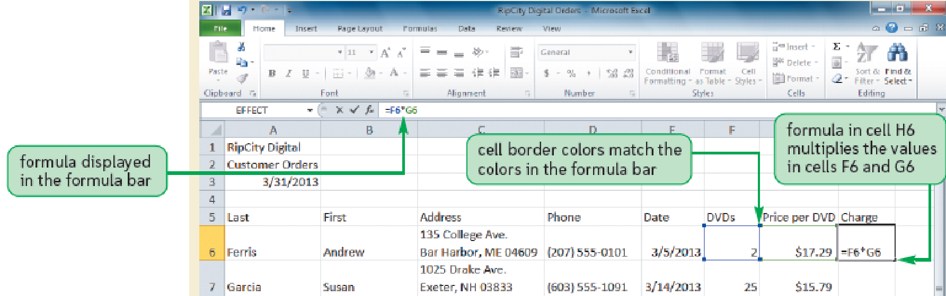
Working with Formulas
Viewing a formula
Select cell and review expression displayed in the formula bar
Each cell reference is color coded in the formula and corresponding cell in the worksheet

Slide 28
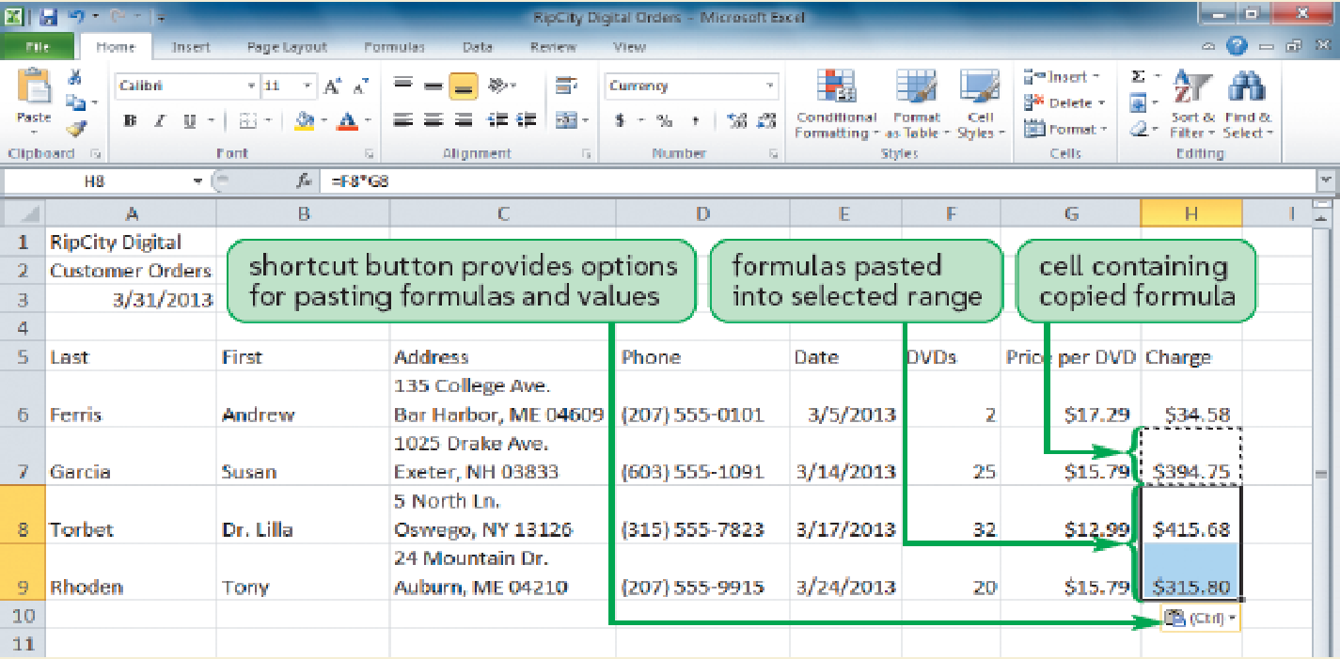
Working with Formulas
Copying and pasting formulas
Cell references adjust to reflect new location of the formula in the worksheet

Slide 29
Working with Formulas
Guidelines for writing effective formulas:
Keep them simple
Do not hide data values within formulas
Break up formulas to show intermediate results

Slide 30
Sample Project Part 3
Copy and paste practice
-Type two new numbers into two adjacent cells
-Copy your formula and paste it into new location
-Confirm that the formula was successfully pasted

Slide 31
Questions?

